Slide 1

DATA STRUCTURES

Slide 2
Data Structure
CLASSIFICATION
Primitive Data Structures
Non-primitive Data Structures

Slide 3
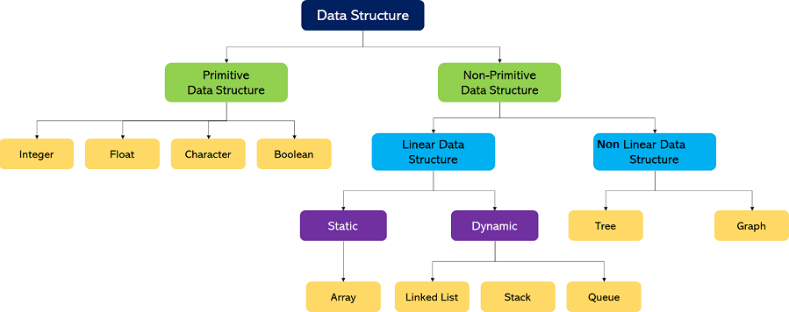
Data Structure

Slide 4
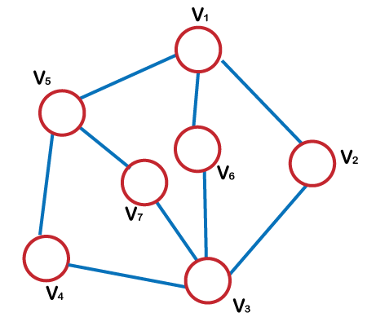
Data Structure - Graph

Slide 5
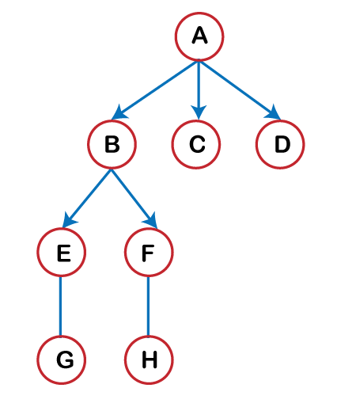
Data Structure - Graph

Slide 6
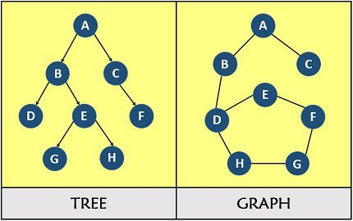
Data Structure - Graph

Slide 7
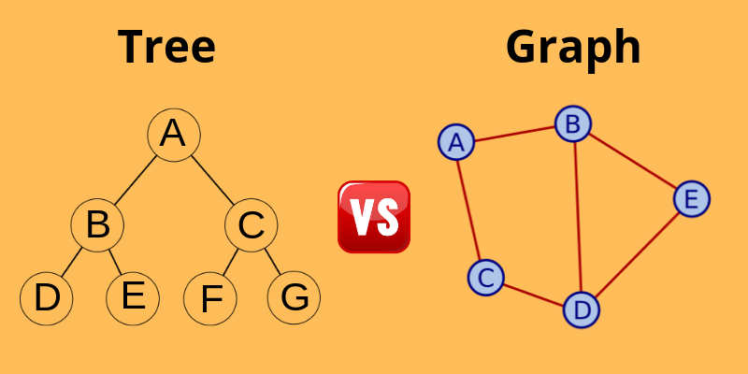
Data Structure - Graph

Slide 8
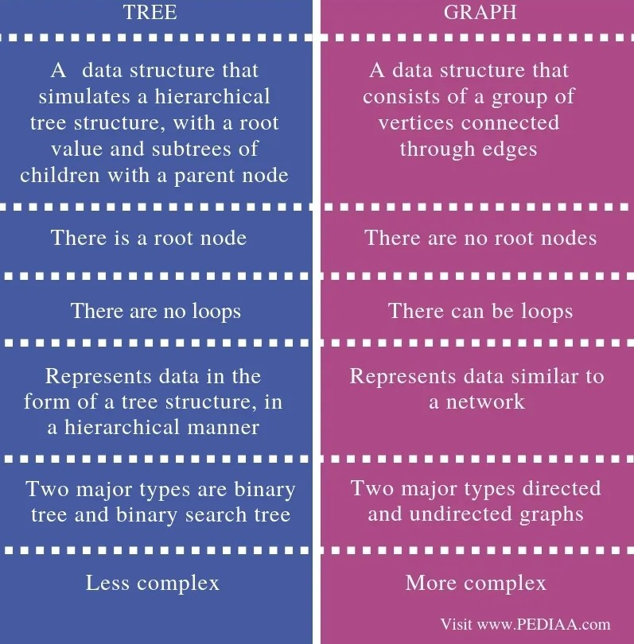

Slide 9
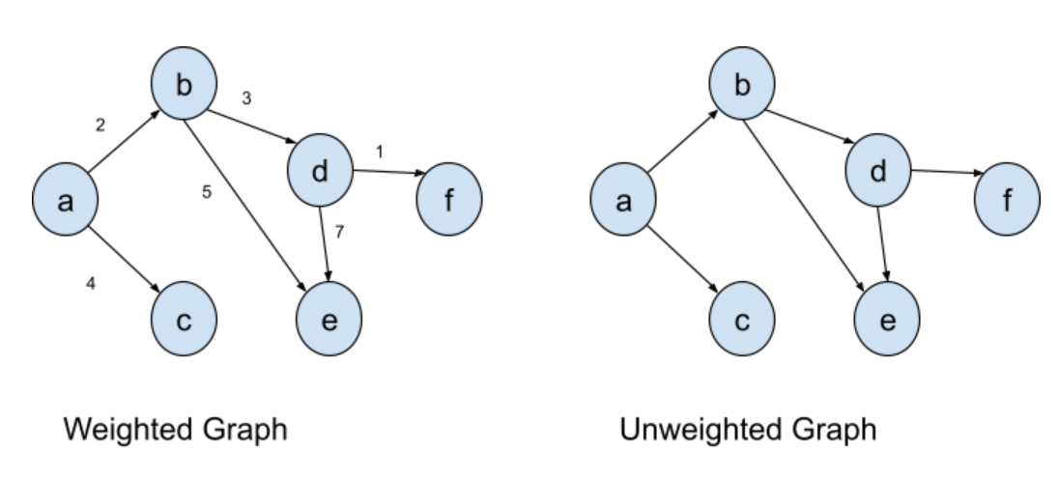
Data Structure - Graph

Slide 10
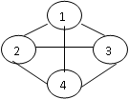
A graph G = (V,E) is composed of:
V: set of vertices
E: set of edges connecting the vertices in V
Vertices are referred to as nodes and the arc between the nodes are referred to as Edges.
Each edge is a pair (v, w) where v, w Ɛ V. (i.e.) v = V1, w = V2..
G:
Here V(G)=(1,2,3,4) and E(G) = {(1,2),(1,3),(1,4),(2,3),(2,4)}.

Slide 11
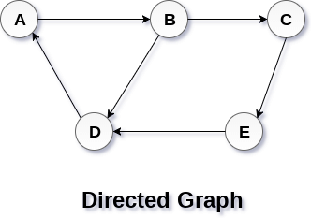
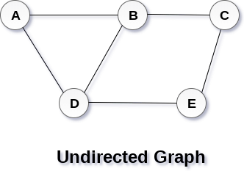
BASIC TERMINOLOGIES
Directed Graph (or) Digraph
Directed graph is a graph which consists of directed edges, where each edge in E is unidirectional. It is also referred as Digraph.
If (v, w) is a directed edge then (v, w) # (w,v)
Undirected Graph
An undirected graph is a graph, which consists of undirected edges.
If (v, w) is an undirected edge then (v,w) = (w, v)

Slide 12
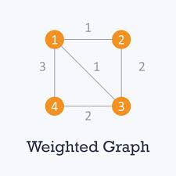
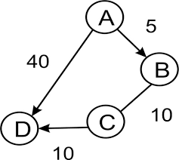
Weighted Graph
A graph is said to be weighted graph if every edge in the graph is assigned a weight or value. It can be directed or undirected graph.
Complete Graph
A complete graph is a graph in which there is an edge between every pair of vertices.
A complete graph with n vertices will have n (n - 1)/2 edges.
Number of vertices is 4
Number of edge is 6
There is a path from every vertex to every other vertex
A complete digraph is a strongly connected graph

Slide 13
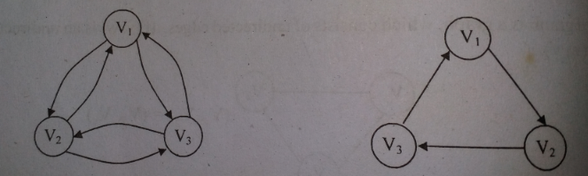
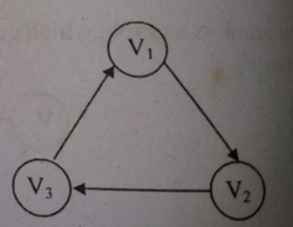
Strongly Connected Graph
If there is a path from every vertex to every other vertex in a directed graph then it is said to be strongly connected graph. Otherwise, it is said to be weakly connected graph.
Path
A path in a graph is a sequence of vertices w1,w2,wn such that wi ,wi+1 Ɛ E for 1≤i≤N. The path rom v1 to v is v1,v2,v3.

Slide 14
Length
The length of the path is the number of edges on the path, which is equal to N-1, where N represents the number of vertices.
The length of the above path V1 to V3 is 2. (i.e) (V1, V2), (V2, V3).
If there is a path from a vertex to itself, with no edges, then the path length is 0.
Loop
If the graph contains an edge (v, v) from a vertex to itself, then the path is referred to as a loop.
Simple Path
A simple path is a path such that all vertices on the path, except possibly the first and the last are distinct.
A simple cycle is the simple path of length atleast one that begins and ends at the same vertex.

Slide 15
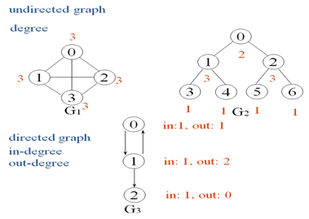
Cycle
A cycle in a graph is a path in which first and last vertex are the same.
Degree
The number of edges incident on a vertex determines its degree. The degree of the vertex V is written as degree (V).
The indegree of the vertex V, is the number of edges entering into the vertex V.
Similarly the out degree of the vertex V is the number of edges exiting from that vertex V.

Slide 16
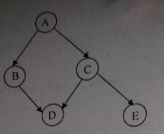
ACyclic Graph
A directed graph which has no cycles is referred to as acyclic graph. It is abbreviated as DAG.
DAG - Directed Acyclic Graph.

Slide 17
Graph Representations
Adjacency Matrix
Adjacency Lists

Slide 18
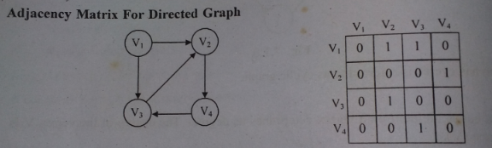
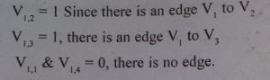
Adjacency Matrix
One simple way to represents a graph is Adjacency Matrix.
The adjacency Matrix A for a graph G = (V, E) with n vertices is an n x n matrix, such that
Aij = 1, if there is an edge Vi to Vj
Aij = 0, if there is no edge.

Slide 19
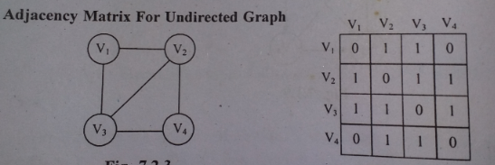
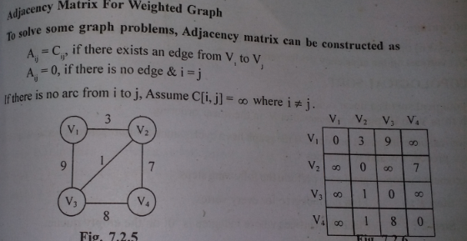
Advantage
* Simple to implement.
Disadvantage
* Takes O(n2) space to represents the graph
* It takes O(n2) time to solve the most of the problems.

Slide 20
Examples for Adjacency Matrix
0
0
4
0
2
1
5
1
2
3
6
3
1
7
2
G2
G1
symmetric
undirected: n²/2
directed: n²
G4

Slide 21
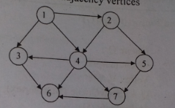
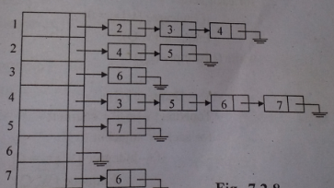
Adjacency List Representation
In this representation, we store a graph as a linked structure. We store all vertices in a list and then for each vertex, we have a linked list of its adjacency vertices
Disadvantage
* It takes 0(n) time to determine whether there is an arc from vertex i to vertex j. Since there can be 0(n) vertices on the adjacency list for vertex i.

Slide 22
0
0
4
2
1
5
1
2
3
6
3
7
0
1
2
3
1
2
3
0
1
2
3
4
5
6
7
1
2
0
2
3
0
3
0
1
3
0
3
0
1
2
1
2
G1
0
5
4
6
0
1
2
1
5
7
0
2
1
6
G3
G4
2
An undirected graph with n vertices and e edges ==> n head nodes and 2e list nodes

Slide 23
Topological Sort
A topological sort is a linear ordering of vertices in a directed acyclic graph such that if there is a path from Vi to Vj, then Vj appears after Vi in the linear ordering.
Topological ordering is not possible. If the graph has a cycle, since for two vertices v and w on the cycle, v precedes w and w precedes v.

Slide 24
To implement the topological sort, perform the following steps.
Step 1 : - Find the indegree for every vertex.
Step 2 : - Place the vertices whose indegree is `0' on the empty queue.
Step 3 : - Dequeue the vertex V and decrement the indegree's of all its adjacent
vertices.
Step 4 : - Enqueue the vertex on the queue, if its indegree falls to zero.
Step 5 : - Repeat from step 3 until the queue becomes empty.
Step 6 : - The topological ordering is the order in which the vertices dequeued.

Slide 25
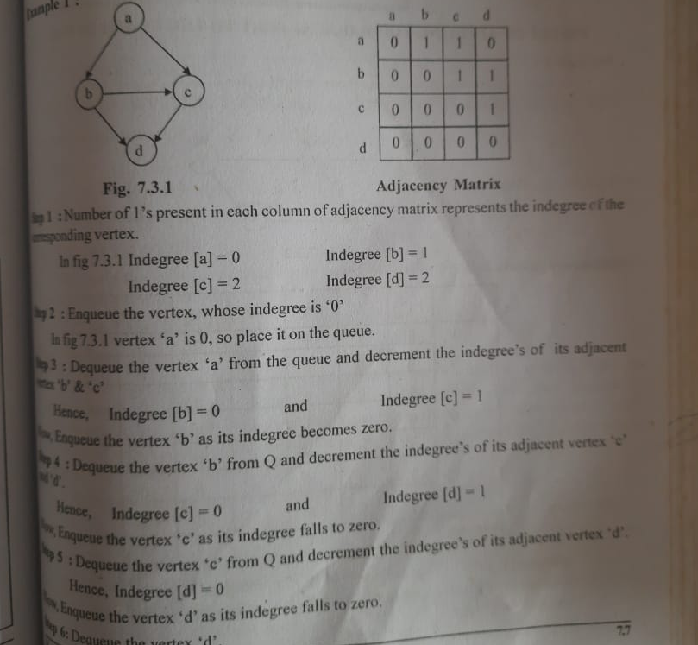

Slide 26
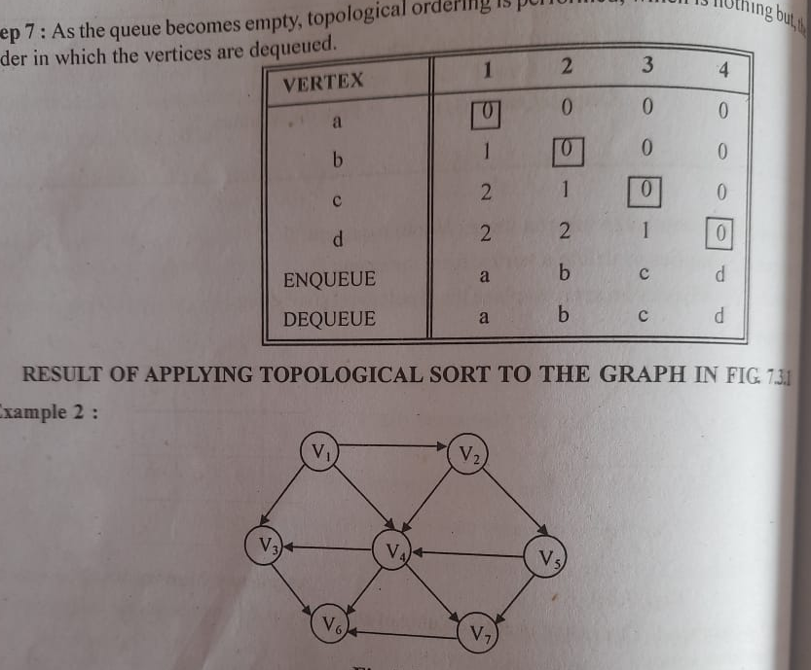

Slide 27
Routine to perform Topological Sort
/* Assume that the graph is read into an adjacency matrix and that the indegrees are computed for every vertices and placed in an array (i.e. Indegree [ ] ) */
void Topsort (Graph G)
{
Queue Q ;
int counter = 0;
Vertex V, W ;
Q = CreateQueue (NumVertex);
Makeempty (Q);
for each vertex V
if (indegree [V] = = 0)
Enqueue (V, Q);
while (! IsEmpty (Q))
{
V = Dequeue (Q);
TopNum [V] = + + counter;
for each W adjacent to V
if (--Indegree [W] = = 0)
Enqueue (W, Q);
}
if (counter ! = NumVertex)
Error (" Graph has a cycle");
DisposeQueue (Q); /* Free the Memory */
}

Slide 28
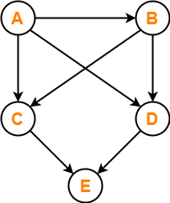
Note :
Enqueue (V, Q) implies to insert a vertex V into the queue Q.
Dequeue (Q) implies to delete a vertex from the queue Q.
TopNum [V] indicates an array to place the topological numbering.
Example

Slide 29
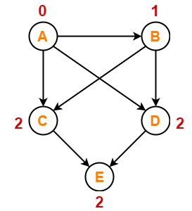
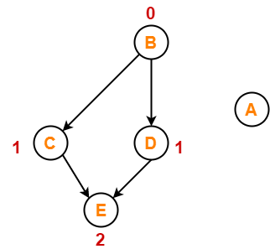
Step-01:
Write in-degree of each vertex-
Step-02:
Vertex-A has the least in-degree.
So, remove vertex-A and its associated edges.
Now, update the in-degree of other vertices.

Slide 30
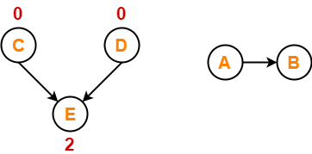
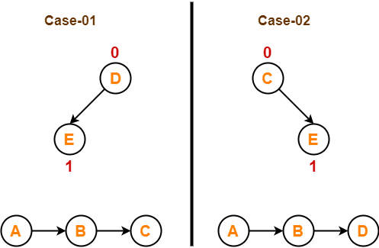
Step-03:
Vertex-B has the least in-degree.
So, remove vertex-B and its associated edges.
Now, update the in-degree of other vertices.
Step-04:
There are two vertices with the least in-degree. So, following 2 cases are possible-
In case-01,
Remove vertex-C and its associated edges.
Then, update the in-degree of other vertices.
In case-02,
Remove vertex-D and its associated edges.
Then, update the in-degree of other vertices.

Slide 31
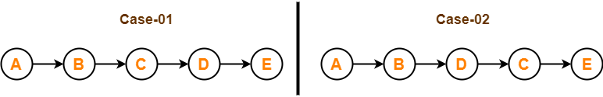
Step-05:
Now, the above two cases are continued separately in the similar manner.
In case-01,
Remove vertex-D since it has the least in-degree.
Then, remove the remaining vertex-E.
In case-02,
Remove vertex-C since it has the least in-degree.
Then, remove the remaining vertex-E.
Conclusion-
For the given graph, following 2 different topological orderings are possible-
A B C D E
A B D C E

Slide 32
Graph Traversal
A graph traversal is a systematic way of visiting the nodes in a specific order.
Depth First Traversal
Breadth first Traversal
The Breadth First Search (BFS) traversal is an algorithm, which is used to visit all of the nodes of a given graph.
In this traversal algorithm one node is selected and then all of the adjacent nodes are visited one by one.
After completing all of the adjacent vertices, it moves further to check another vertices and checks its adjacent vertices again.

Slide 33
Step1 : choose any node in the graph, designate it as the search node & mark it as visited
Setp 2: Using the adjacency matrix of the graph, find all the univisted adjacent node and enqueue them into queue Q
Step 3: then the node is dequeued from the queue. Mark that node as visited and designate it as the new search node
Step 4: Repeat the step 2 and 3 using the new search node
Step 5: this process continues until the queue Q which keeps track of the adjacent nodes is empty.

Slide 34
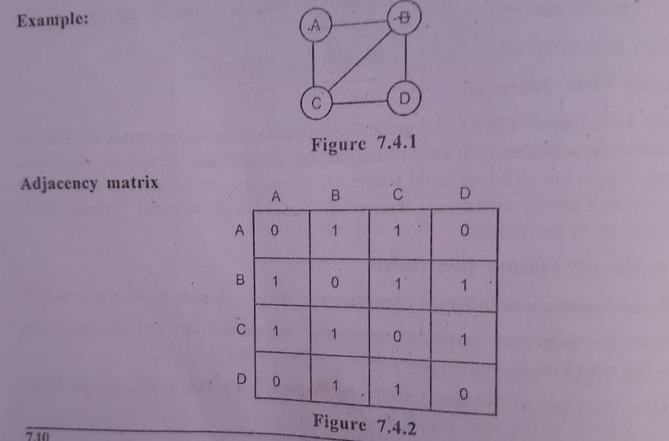

Slide 36
Algorithm BFS gives the details.
Procedure BFS(v)
//A breadth first search of G is carried out beginning at vertex v. All vertices visited are marked as VISITED(I) = 1. The graph G and array VISITED are global and VISITED is initialised to 0.//
VISITED(v) ← 1
Initialise Q to be empty //Q is a queue//
loop
for all vertices w adjacent to v do
if VISITED(w) = 0 //add w to queue//
then [call ADDQ(w, Q); VISITED(w) ← 1] //mark w as VISITED//
end
if Q is empty then return
call DELETEQ(v,Q)
forever
end BFS

Slide 37
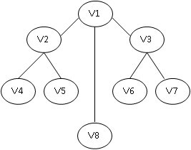
Let us consider the same example, given in figure. We start say, with V₁. Its adjacent vertices are V₂, V₈ , V₃ . we visit all one by one. We pick on one of these, say V₂. The unvisited adjacent vertices to V₂ are V₄, V₅ . we visit both . we back to the remaining visited vertices of V₁ and pick on one of this, say V₃. T The unvisited adjacent vertices to V₃ are V₆,V₇. There are no more unvisited adjacent vertices of V₈, V₄, V₅, V₆ and V₇. Thus the sequence so generated is V_{1,}V_{2,} V_{8,} V_{3,}V₄, V_{5,}V_{6,} V₇.

Slide 38
COMPUTING TIME:
Each vertex visited gets into the queue exactly once, so the loop forever is iterated at most n times. If an adjacency matrix is used, then the for loop takes O(n) time for each vertex visited. The total time is, therefore, O(n²). In case adjacency lists are used the for loop as a total cost of d₁+……..+d_{n} = O(e) where d_{i} = degree(v_{i}). Again, all vertices visited. Together with all edges incident to from a connected component of G.

Slide 39
DEPTH FIRST SEARCH :
The Depth First Search (DFS) is a graph traversal algorithm. In this algorithm one starting vertex is given, and when an adjacent vertex is found, it moves to that adjacent vertex first and try to traverse in the same manner.
This procedure is best described recursively as in
Procedure DFS(v)
// Given an undirected graph G = (V.E) with n vertices and an array visited (n) initially set to zero . This algorithm visits all vertices reachable from v .G and VISITED are global > //VISITED (v) ← 1
for each vertex w adjacent to v do
if VISITED (w) =0 then call DFS (w)
end
end DFS

Slide 40
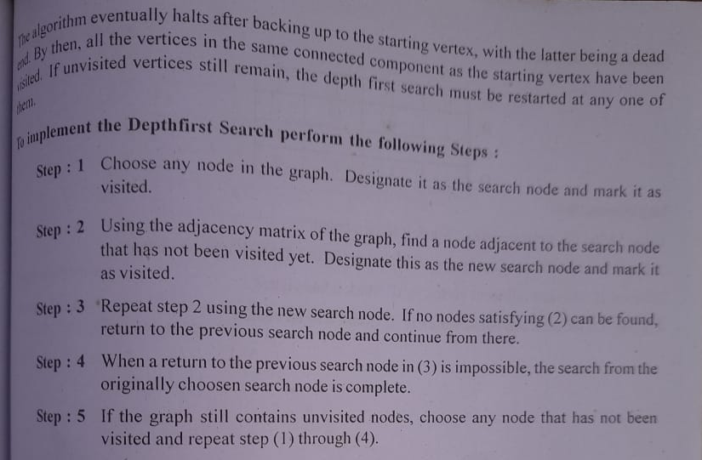

Slide 41
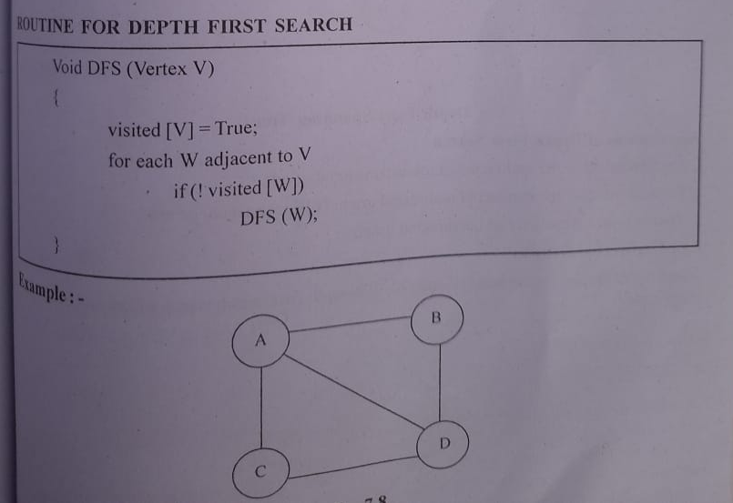

Slide 42
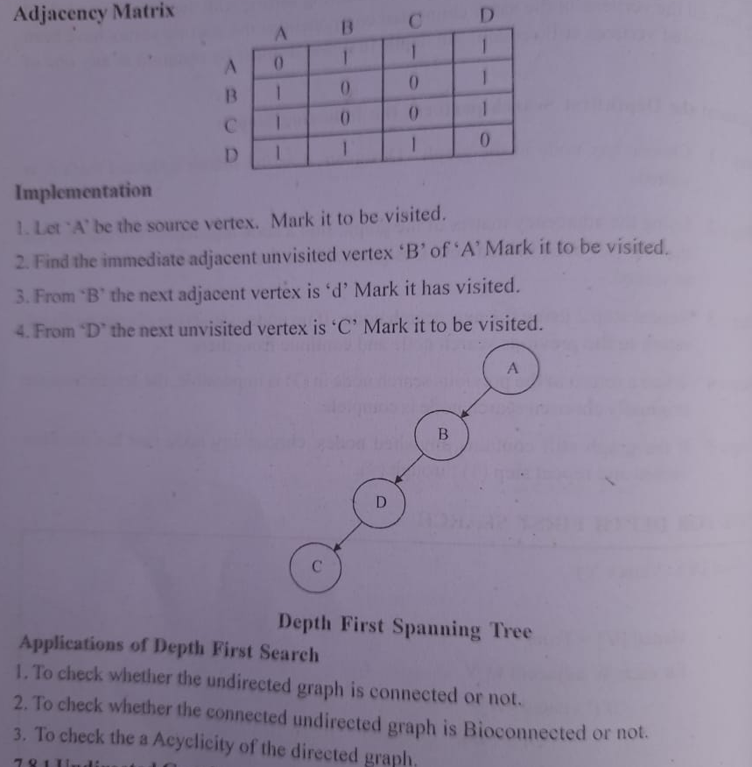

Slide 43
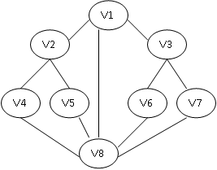
Example
Let us start with V_{1.}
Its adjacent vertices are V2, V8, and V3. Let us pick on v2.
Its adjacent vertices are V1, V4, V5, V1 is already visited . let us pick on V4.
Its adjacent vertices are V2, V8.
V2 is already visited .let us visit V8.
Its adjacent vertices are V4, V5, V1, V6, V7.
V4 and V1 are visited. Let us traverse V5.
Its adjacent vertices are V2, V8. Both are already visited therefore, we back track.
We had V6 and V7 unvisited in the list of V8. We may visit any. We may visit any. We visit V6.
Its adjacent are V8 and V3. Obviously the choice is V3.
Its adjacent vertices are V1, V7 . We visit V7.
All the adjacent vertices of V7 are already visited, we back track and find that we have visited all the vertices.
Therefore the sequence of traversal is
V1, V2, V4, V5, V6, V3, V7.
This is not a unique or the only sequence possible using this traversal method.
We may implement the Depth First search by using a stack,pushing all unvisited vertices to the one just visited and poping the stack to find the next vertex to visit.

Slide 44
COMPUTING TIME:
In case G is represented by adjacency lists then the vertices w adjacent to v can be determined by following a chain of links. Since the algorithm DFS would examine each node in the adjacency lists at most once and there are 2e list nodes. The time to complete the search is O (e). if G is represented by its adjacency matrix. Then the time to determine all vertices adjacent to v is O(n). since at most n vertices are visited. The total time is O(n²).

Slide 45
Application of Graphs
Graphs are used to define the flow of computation.
Graphs are used to represent networks of communication.
Graphs are used to represent data organization.
Graph transformation systems work on rule-based in-memory manipulation of graphs. Graph databases ensure transaction-safe, persistent storing and querying of graph structured data.
Graph theory is used to find shortest path in road or a network.

Slide 46
In Computer science graphs are used to represent the flow of computation.
Google maps uses graphs for building transportation systems, where intersection of two(or more) roads are considered to be a vertex and the road connecting two vertices is considered to be an edge, thus their navigation system is based on the algorithm to calculate the shortest path between two vertices.
In Facebook, users are considered to be the vertices and if they are friends then there is an edge running between them. Facebook’s Friend suggestion algorithm uses graph theory. Facebook is an example of undirected graph.

Slide 47
In World Wide Web, web pages are considered to be the vertices. There is an edge from a page u to other page v if there is a link of page v on page u. This is an example of Directed graph. It was the basic idea behind Google Page Ranking Algorithm.
In Operating System, we come across the Resource Allocation Graph where each process and resources are considered to be vertices. Edges are drawn from resources to the allocated process, or from requesting process to the requested resource. If this leads to any formation of a cycle then a deadlock will occur.

Slide 48
Neural networks: Vertices represent neurons and edges are the synapses between them. Neural networks are used to understand how our brain works and how connections change when we learn. The human brain has about 1011 neurons and close to 1015 synapses.

